Slide 1
Painting Examples

Slide 2
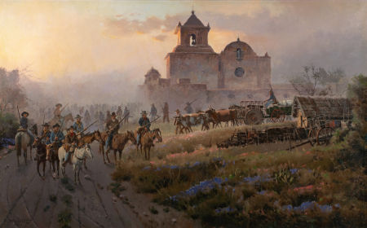
James Boren
Goliad March

Slide 3
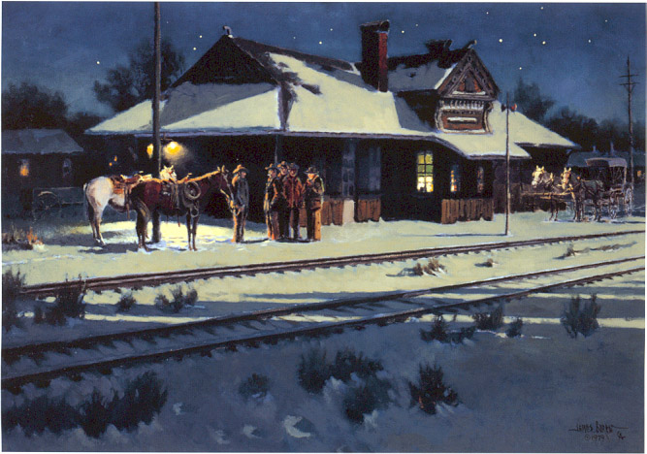
James Boren
Waiting for the Late Train 28x40

Slide 4
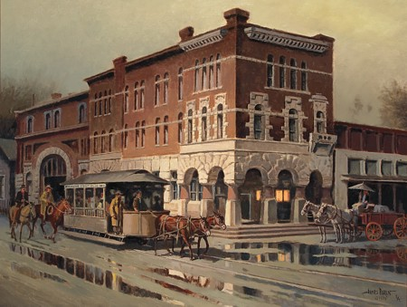
James Boren
Wet Day in Waxahachie 32x42

Slide 5
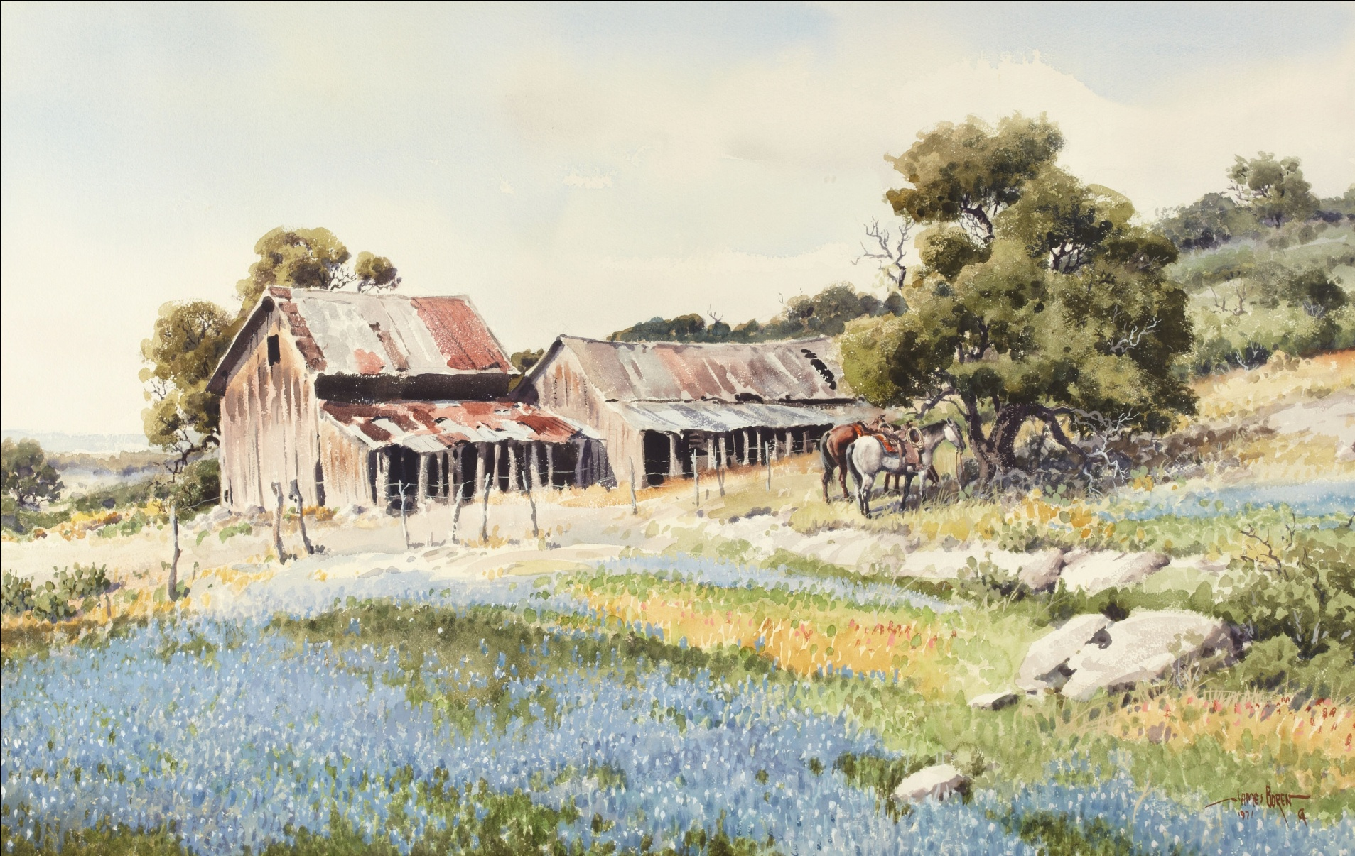
James Boren
Bluebonnets 24x37

Slide 6
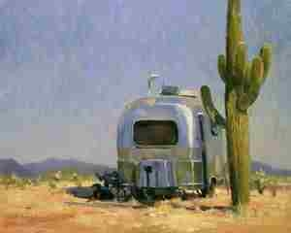
Ken Backhaus
He Thinks This Is Paradise 16x20

Slide 7

Chris Beck
Hollyhocks 29x12

Slide 8
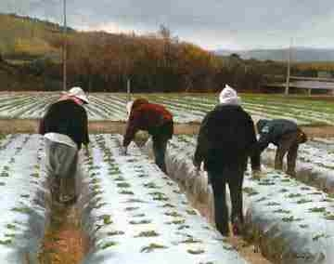
Warren Chang
La Fresa in Winter 16x20

Slide 9
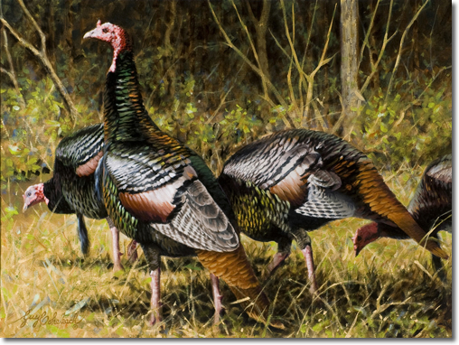
Guy Coheleach
Three and a Half Toms 18x24

Slide 10
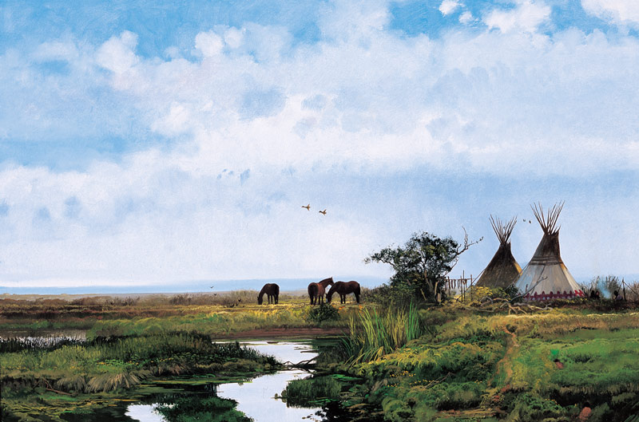
Michael Coleman
Big Sky Country 20x30

Slide 11
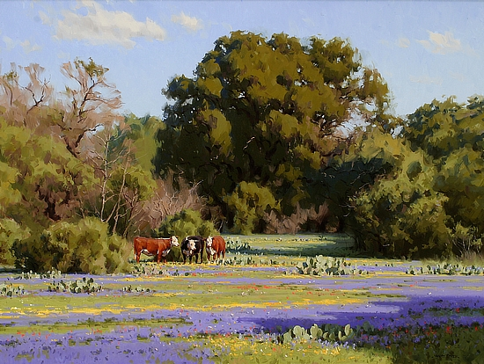
Jimmy Dyer
A Perfect Day

Slide 12
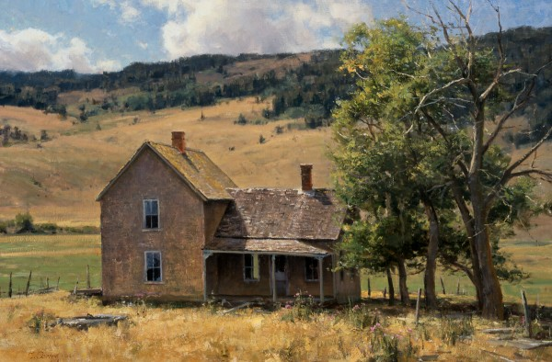
Clyde Aspevig
A Western Saga 24x36

Slide 13
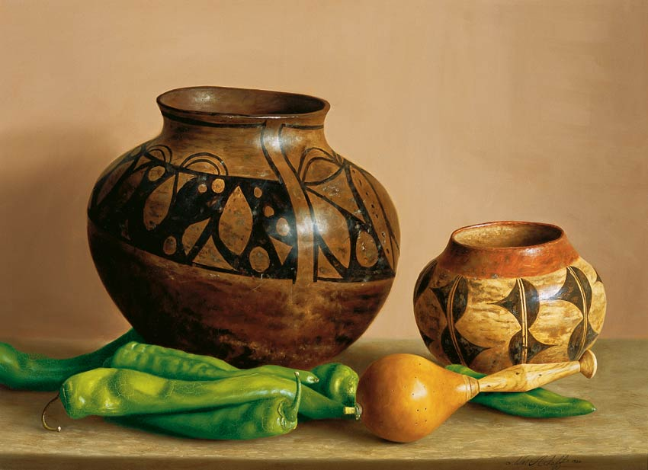
William Acheff
Summer’s Harvest 16x22

Slide 14
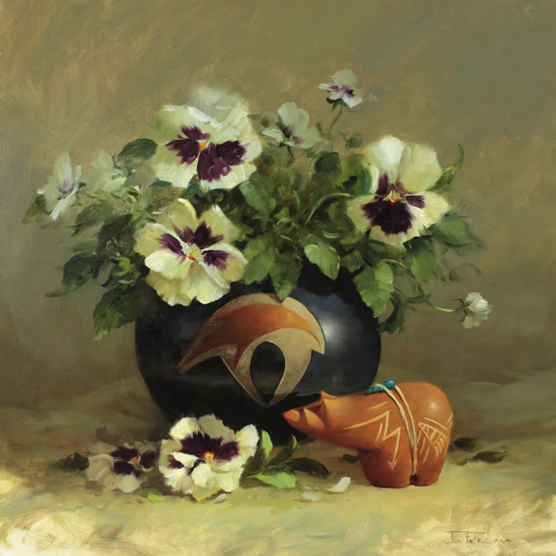
Joni Falk
Pansy Fetish 20x20

Slide 15
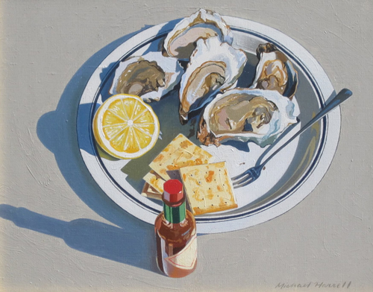
Michael Harrell
Oysters on the Half Shell 8x10

Slide 16
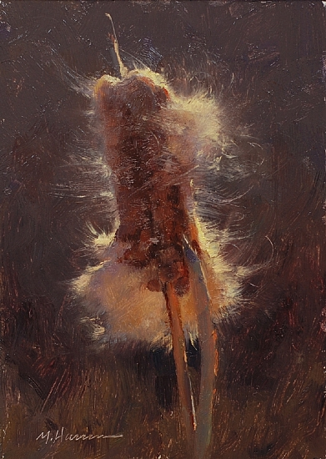
Marc Hanson
Fluff 7x5

Slide 17
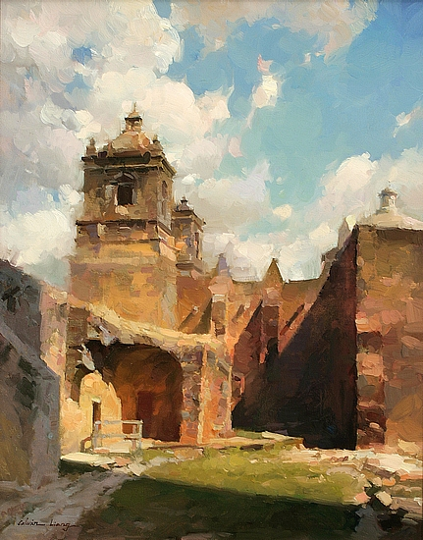
Calvin Liang
Concepcion San Antonio 30x24

Slide 18
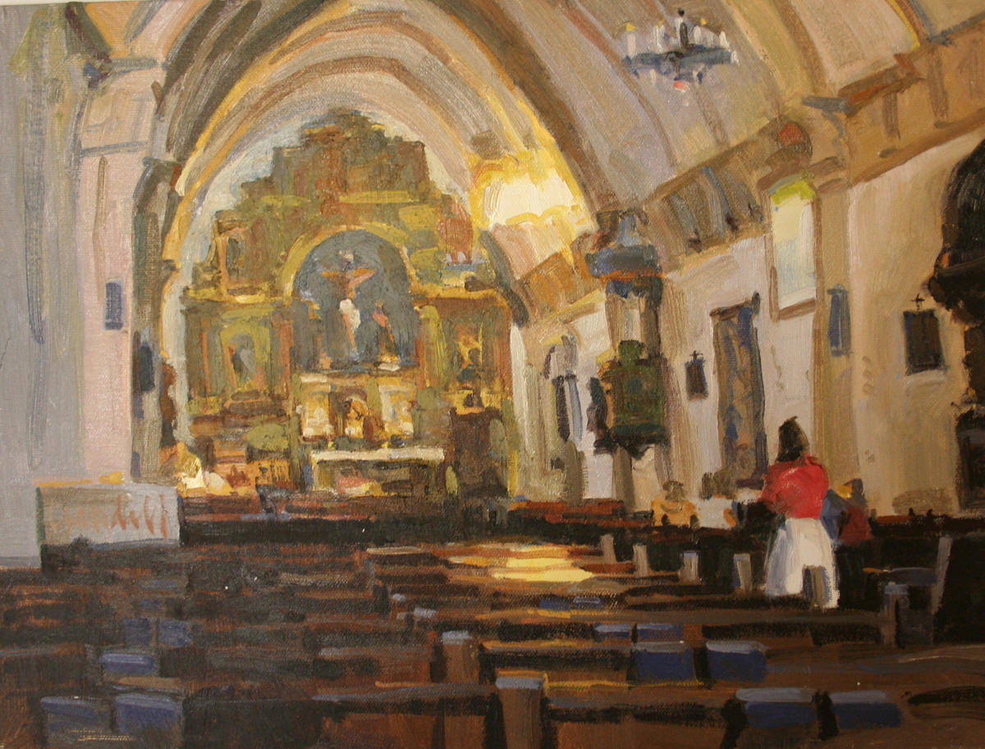
James Crandall
Carmel Mission 12x16

Slide 19
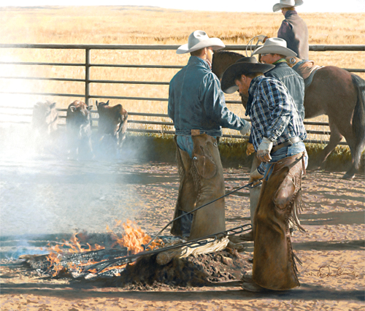
Mike Donahue
Fall Work 20x23

Slide 20
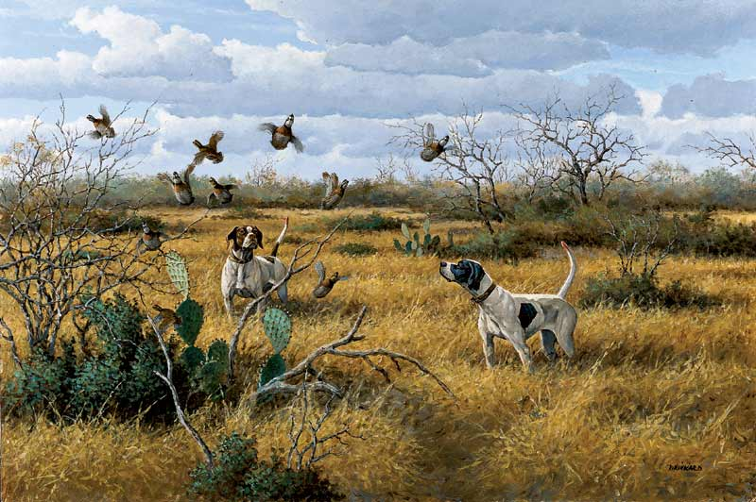
David Drinkard
Bird’s Up 24x36

Slide 21
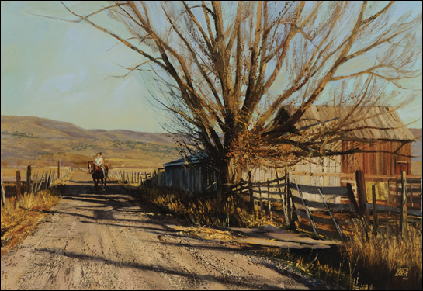
Valoy Eaton
Riding Double 24x35

Slide 22
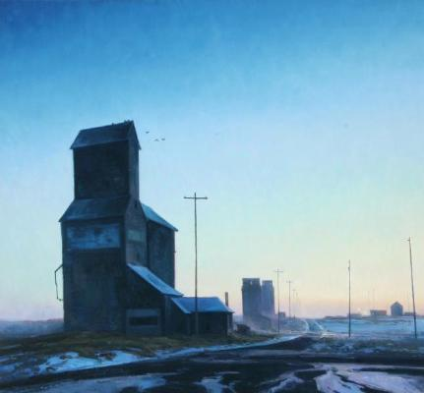
Josh Elliott
Hi-Line Dawn 28x30

Slide 23
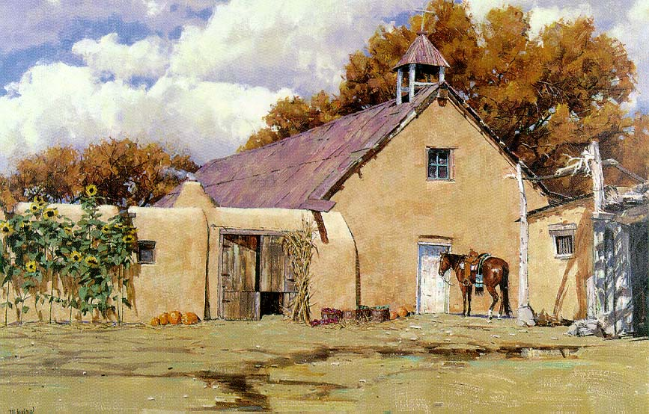
Mike Ewing
A Prayer for the Harvest

Slide 24
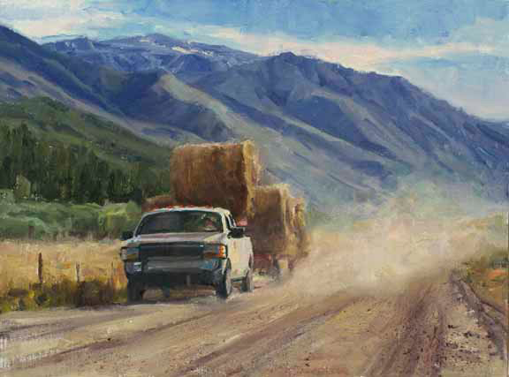
Howard Friedland
Keep on Truckin’ 12x16

Slide 25
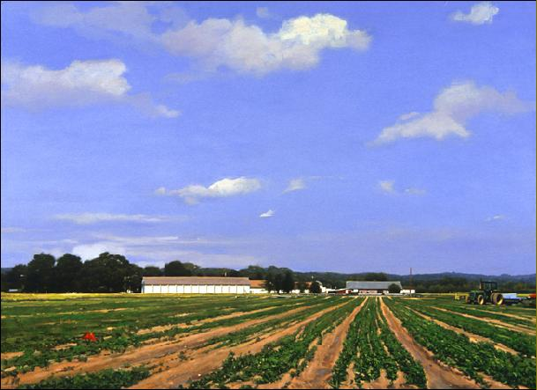
Gary Godbee
Farm-Eastern Long Island 22x28

Slide 26
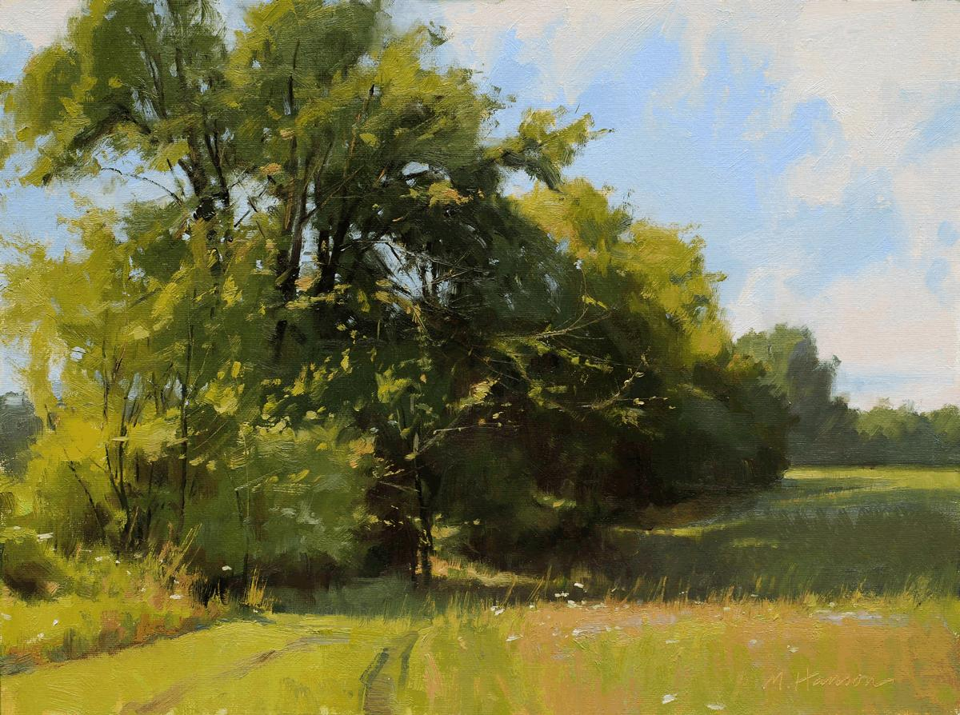
Marc Hanson
Springtime

Slide 27
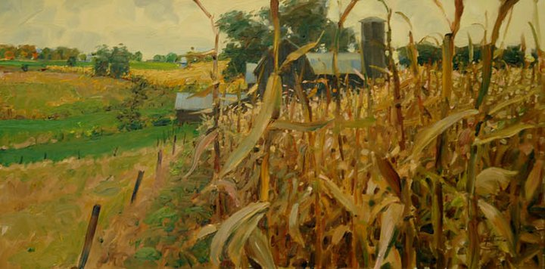
David Hettinger
Corn Field

Slide 28
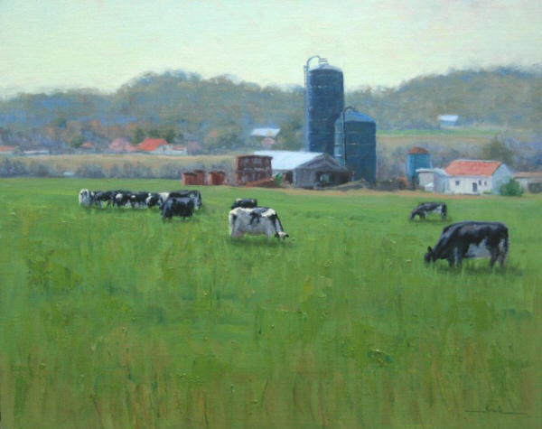
Chuck Rawle
Holstein Heaven 16x20

Slide 29
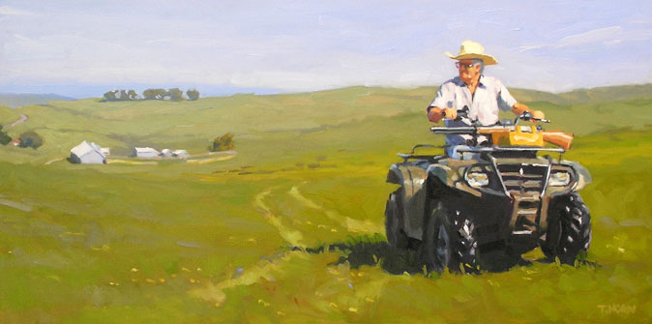
Timothy Horn
Lone Ranger 15x30

Slide 30
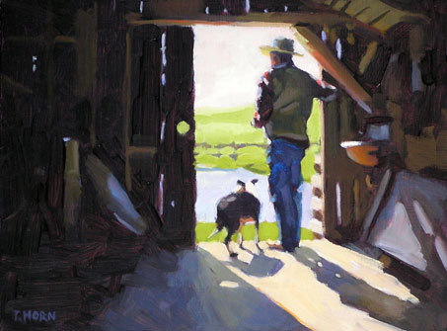
Timothy Horn
Lookout 9x16

Slide 31
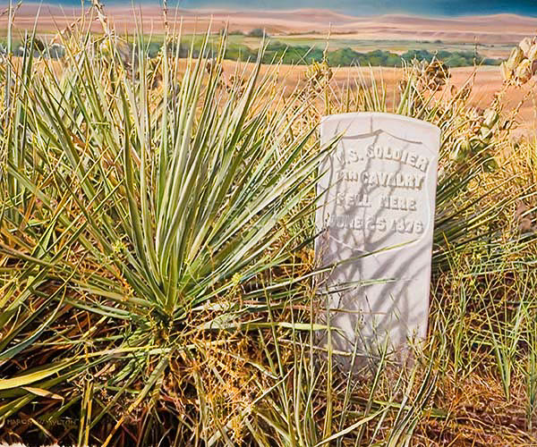
Marion Hylton
One of the Fallen 19x23

Slide 32
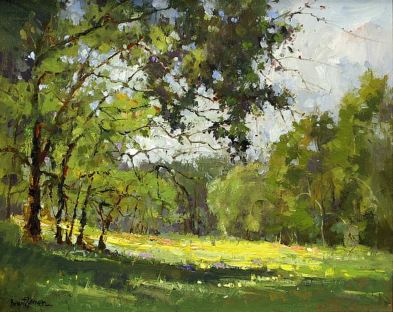
Brent Jensen
A Trees Domain 16x20

Slide 33
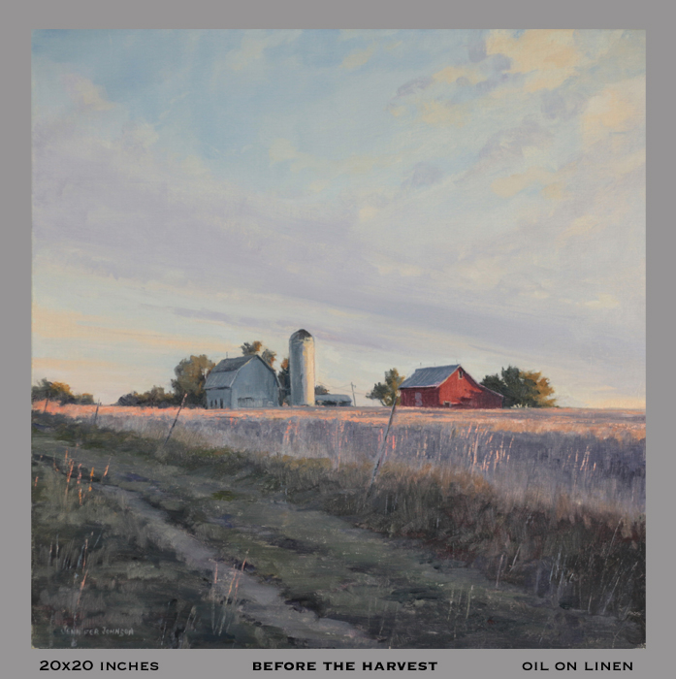
Jennifer Johnson
Before the Harvest 20x20

Slide 34
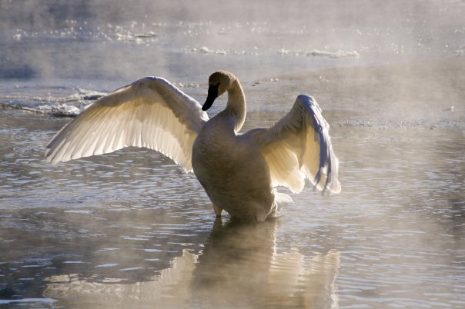
Mallory Jones
Morning Stretch

Slide 35
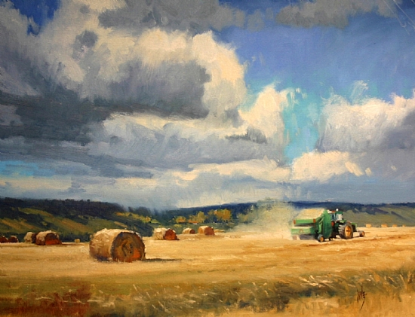
Rusty Jones
Making Hay 22x28

Slide 36
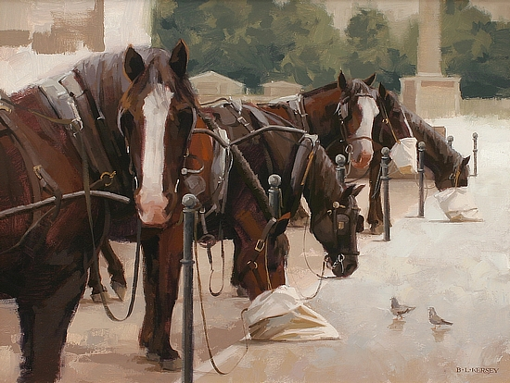
Laurie Kersey
Sack Lunch 11x14

Slide 37
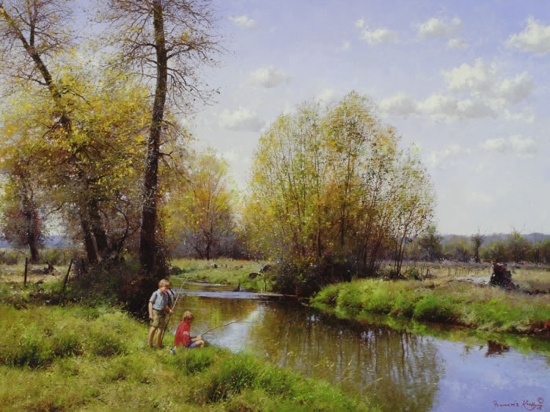
Francois Koch
Great Expectations 30x40

Slide 38
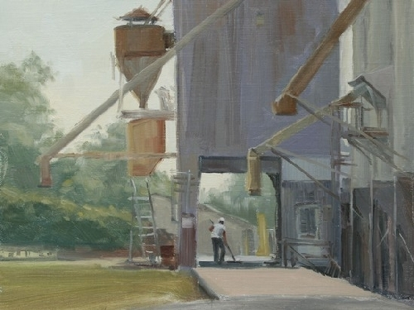
Greg LaRock
Wheat Sweepers 11x14

Slide 39
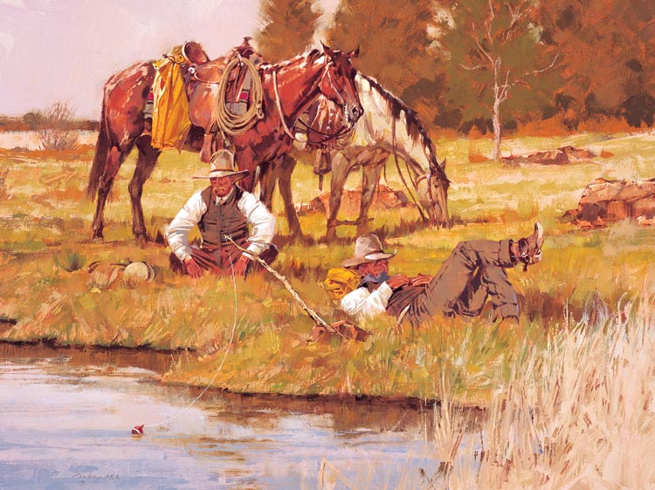
Kim Mackey
While the Boss is Away 18x24

Slide 40
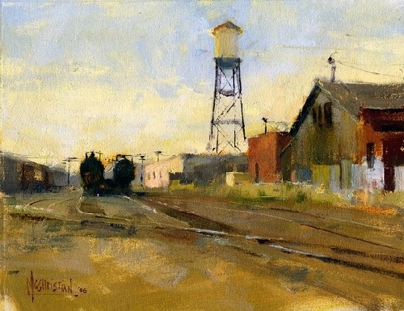
Jennifer McChristian
Old Paper Mill 7x9

Slide 41
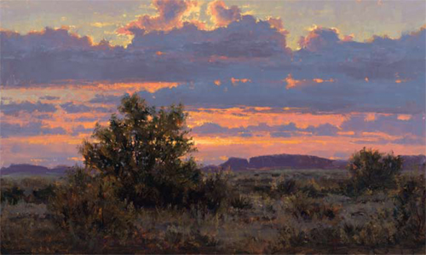
Kenny McKenna
Panhandle Sunset 18x30

Slide 42
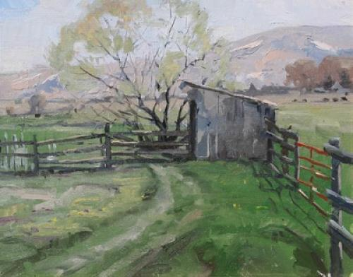
Robert Moore
The Shed 16x20

Slide 43
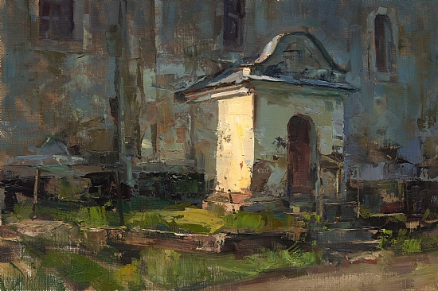
Tibor Nagy
Country Church 12x18

Slide 44
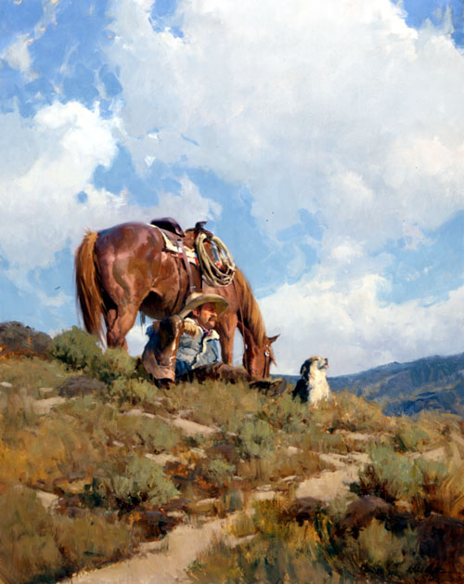
Bill Anton
New Horizons 60x48

Slide 45
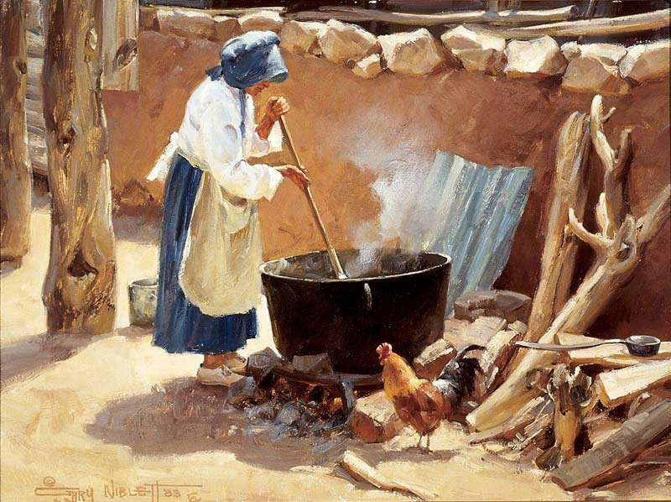
Gary Niblett
Cowboy Soap 12x16

Slide 46
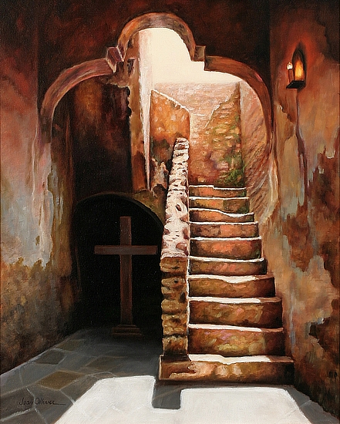
Jean Oliver
Stairway to Heaven 20x16

Slide 47
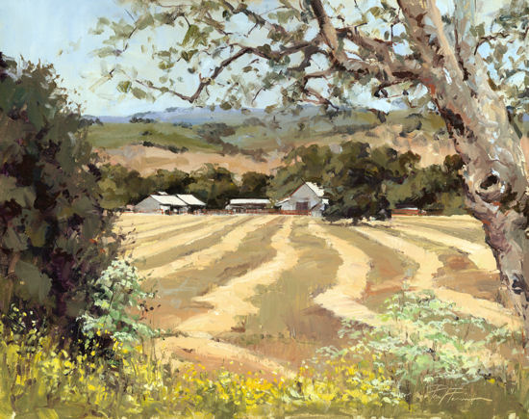
Paul Panossian
Field of Dreams 14x18

Slide 48
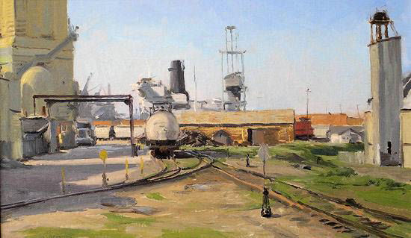
Joe Paquet
White Tanker

Slide 49
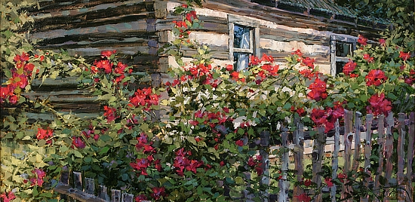
Peet Darcie
Twine Through the Hill Country 15x30

Slide 50
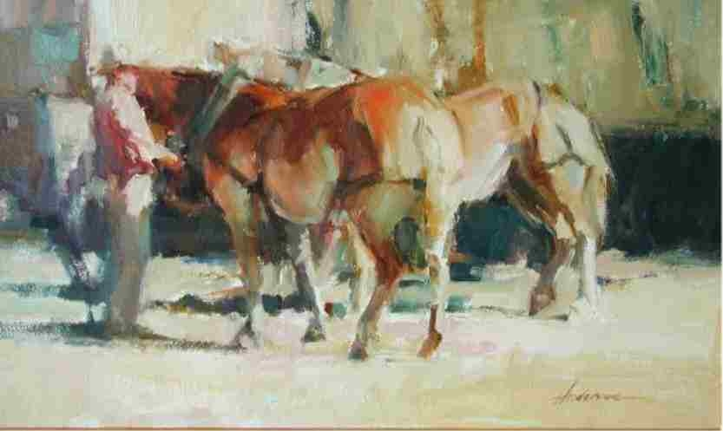
Carolyn Anderson
Draft Horses

Slide 51
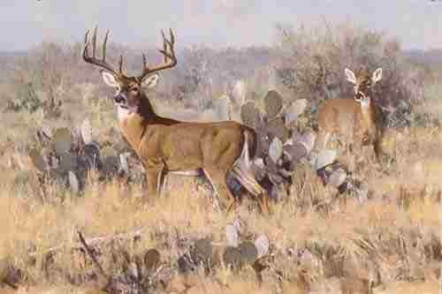
Ken Carlson
Phantom of the Flats

Slide 52
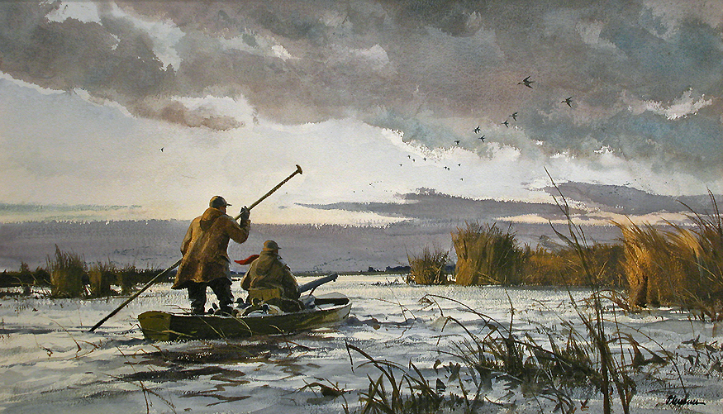
Ogden Pleissner
To the North Blind 16x28

Slide 53

Kami Polzin
Prairie Fields 11x14

Slide 54

Marc Hanson
Prairie Fire 24x24

Slide 55

Scott Prior
Pinned Down 30x24

Slide 56

Marc Hanson
Red Gates

Slide 57

Carolyn Anderson
Leading

Slide 58

Carolyn Anderson
Rocky Boy Dancers

Slide 59

Bob Rohm
Luckenbach 16x20

Slide 60

Bob Rohm
Spanish Heritage

Slide 61

Clyde Aspevig
Round Bales

Slide 62

Kyle Sims
Summer Rumble 40x60

Slide 63

W. Jason Situ
Hometown Impression-Rice Field 8x10

Slide 64

David Slonim
The Roofers 28x40

Slide 65

Jill Soukup
Red Tractor 16x24

Slide 66

Sonya Terpening
Stars and Stripes 21x29

Slide 67

Marc Hanson
The Dike Road

Slide 68

Andy Thomas
Black Gold

Slide 69

Robert Watts
The Open Road

Slide 70

Jim Wodark
The Soldiers Bench

Slide 71

Dan Young
Morning Patterns 16x20

