Slide 1
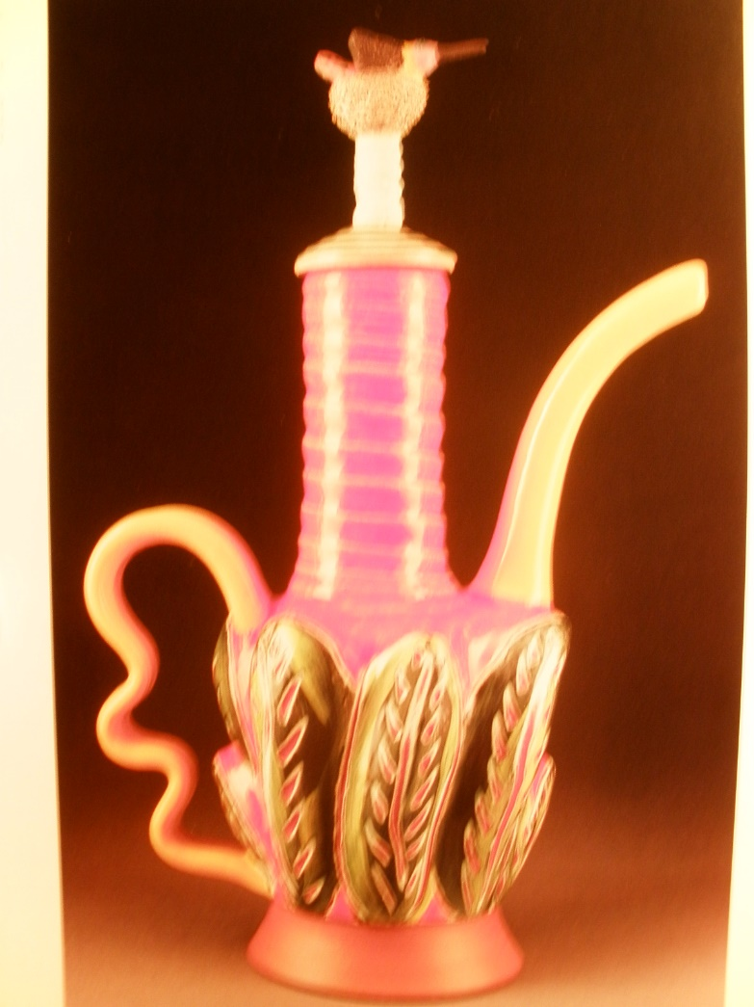
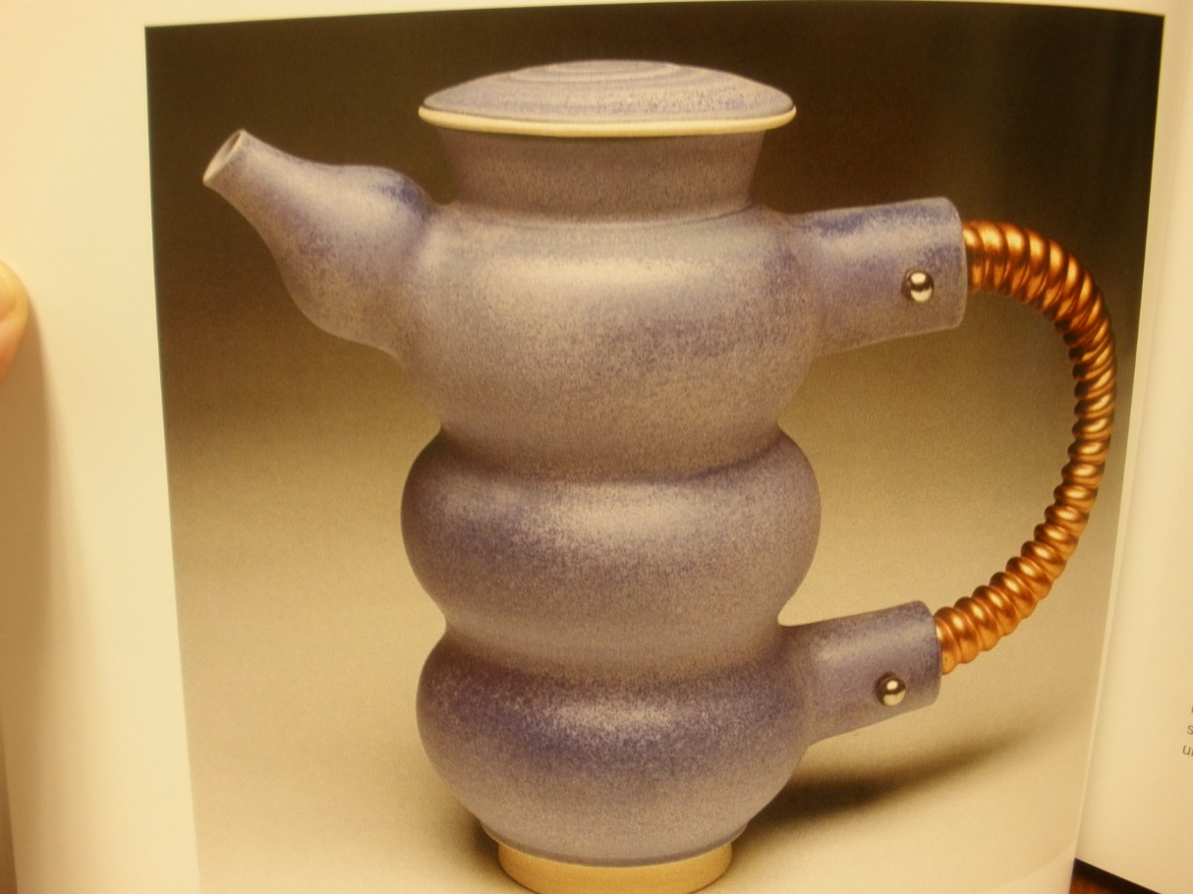
Battle of the Teenagers
And their teapots!

Slide 2
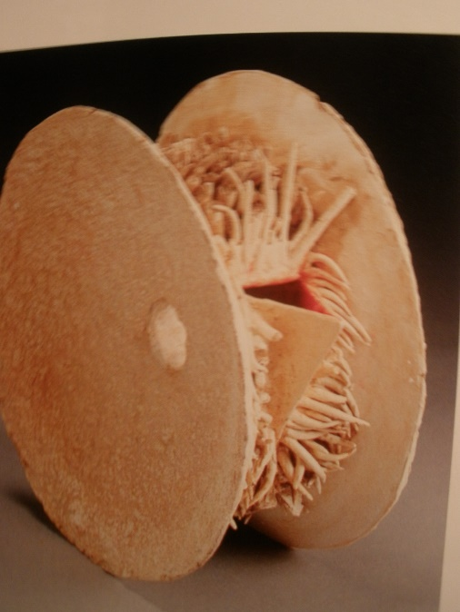
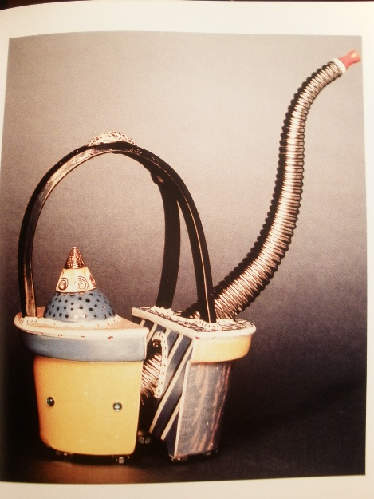
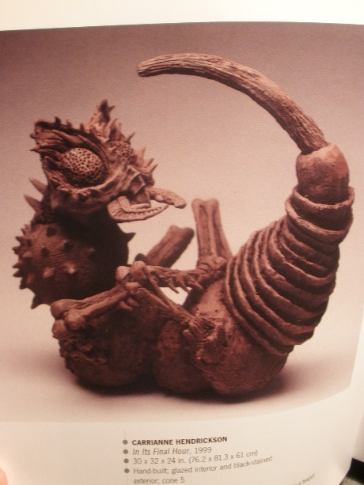
Assignment Objective : Teapot Battle
Students will create a functional vessel to dispense tea…
( or other liquid substance )
( does not have to be a consumable beverage !)
There is more to it than that, you are not just making a vessel to serve tea…
,

Slide 3
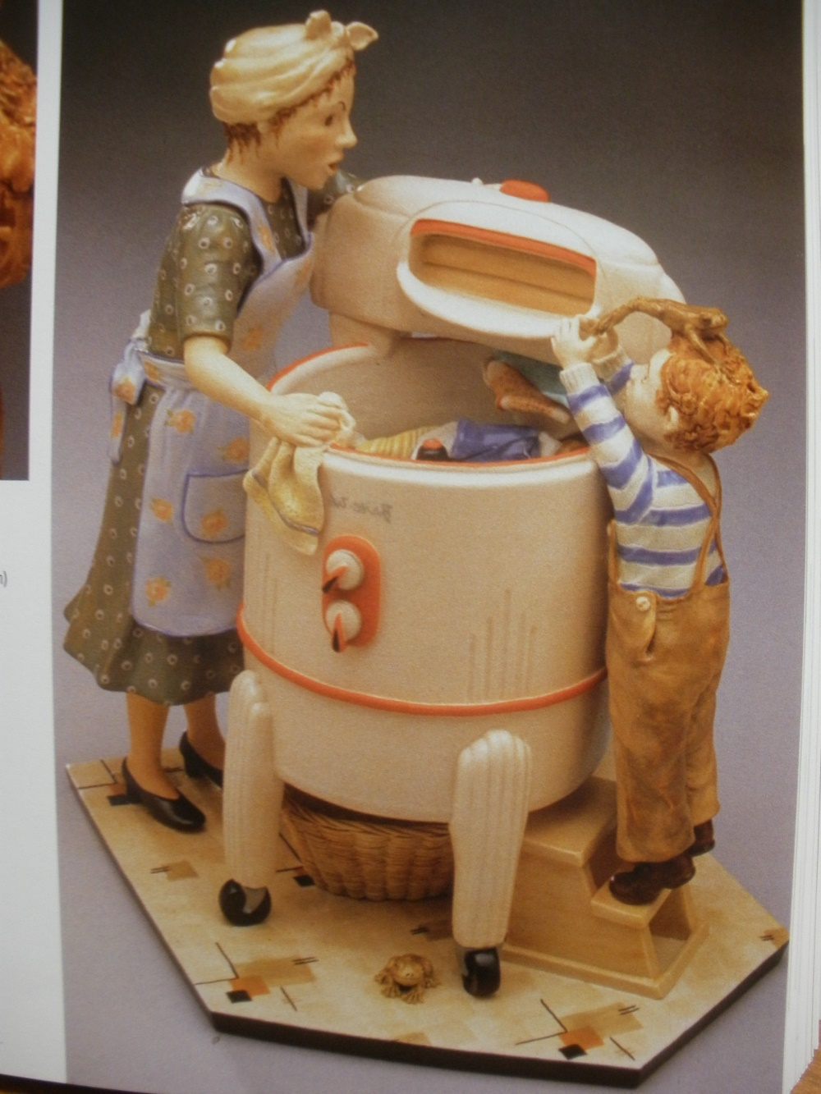
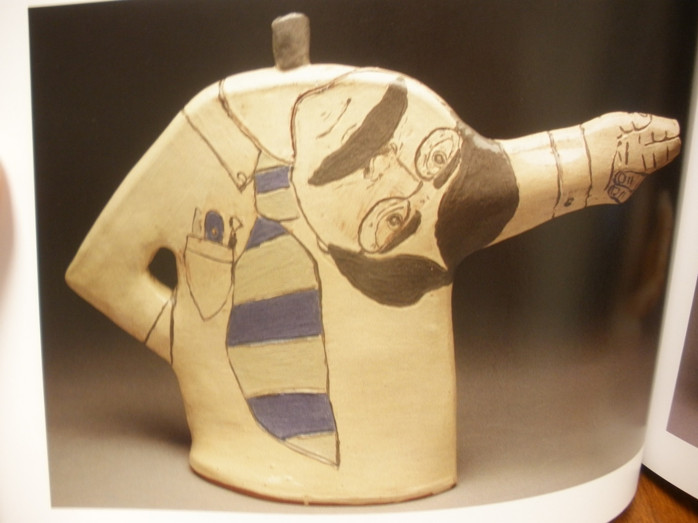
you are making a piece of art that represents something

Slide 5
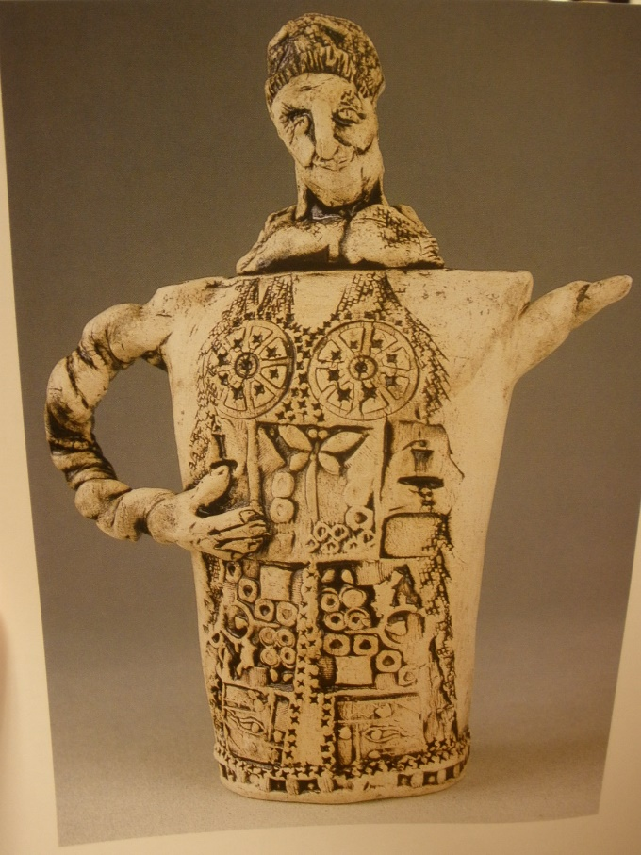
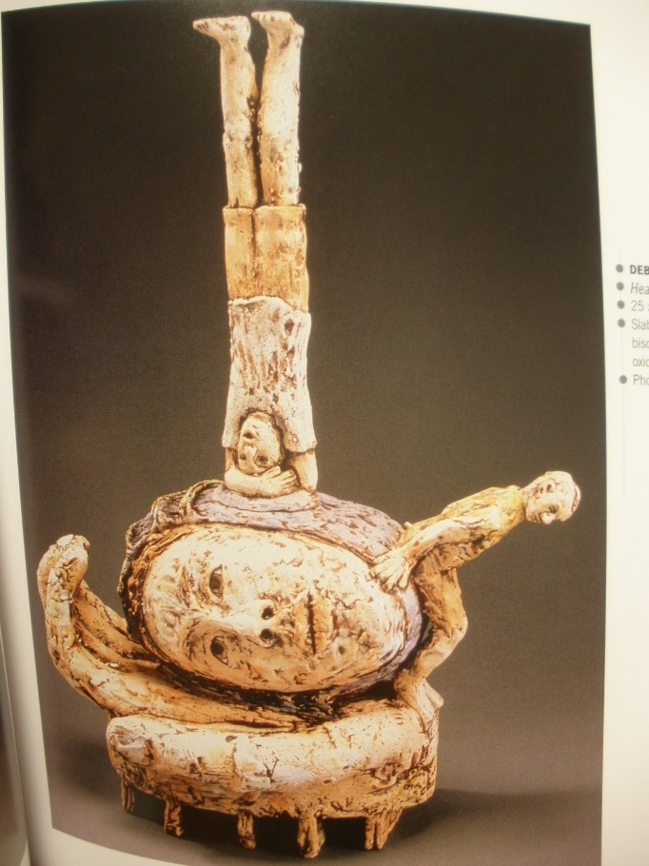
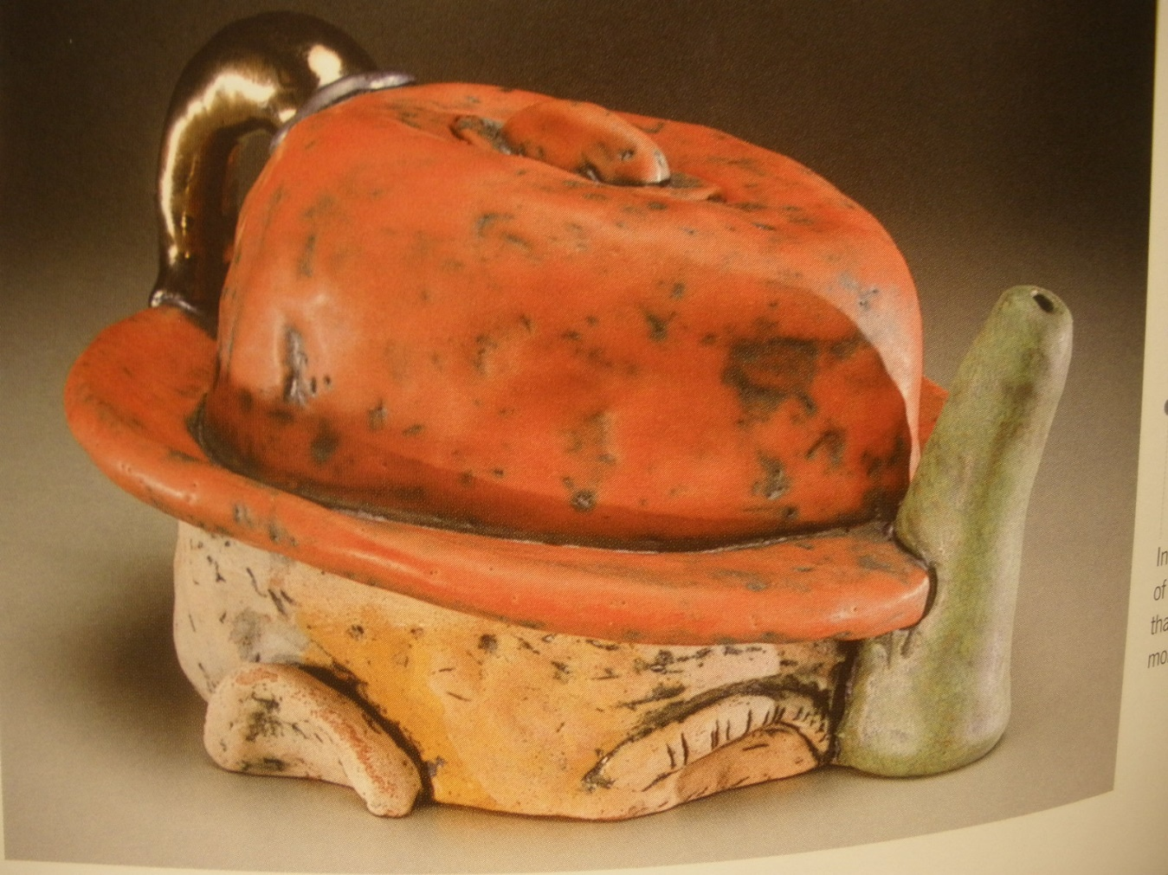
tells a story

Slide 6
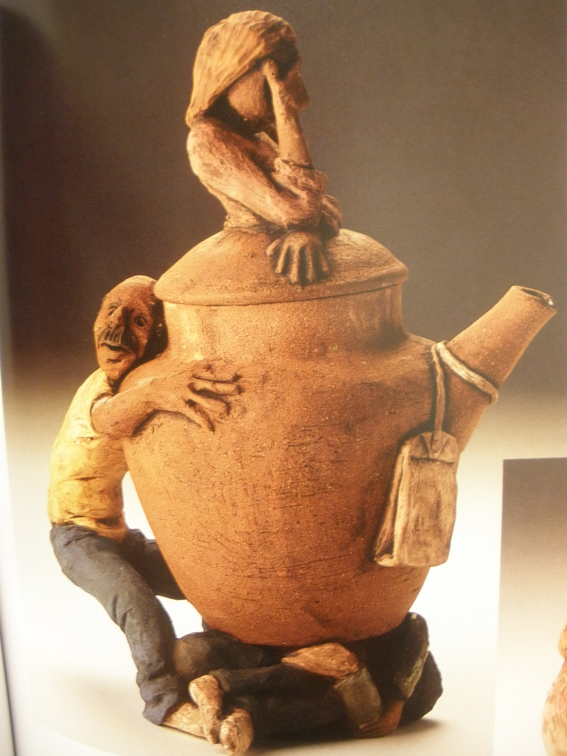
evokes an emotion

Slide 7
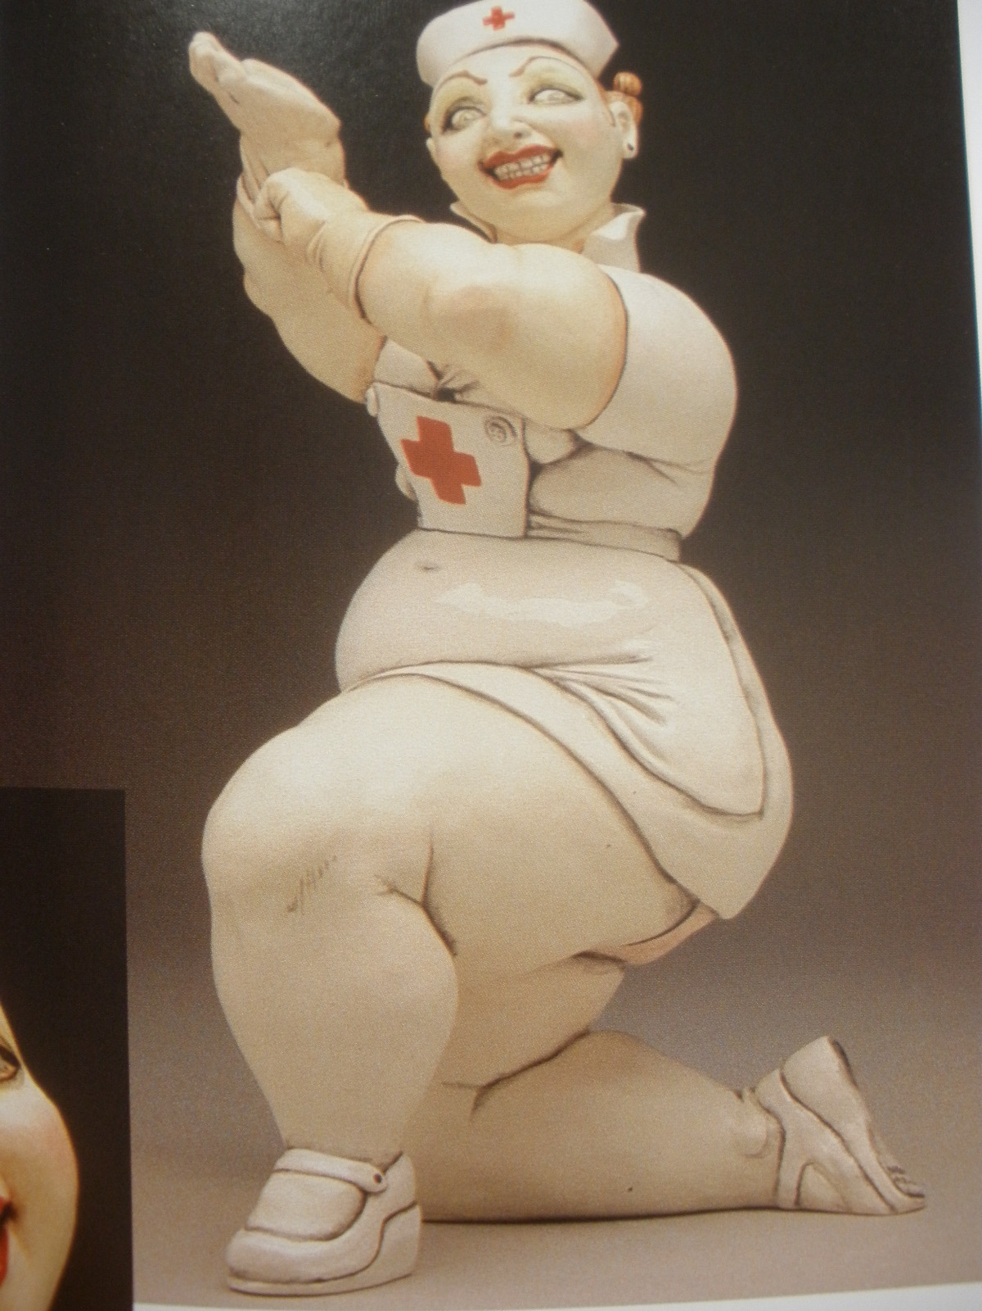
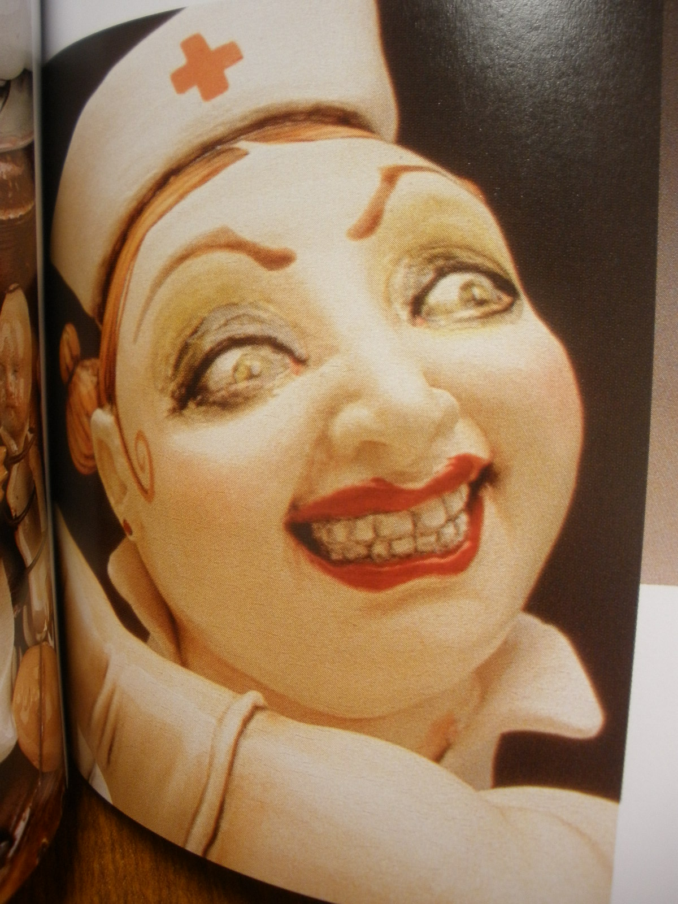
something that catches your viewers eye!

Slide 8
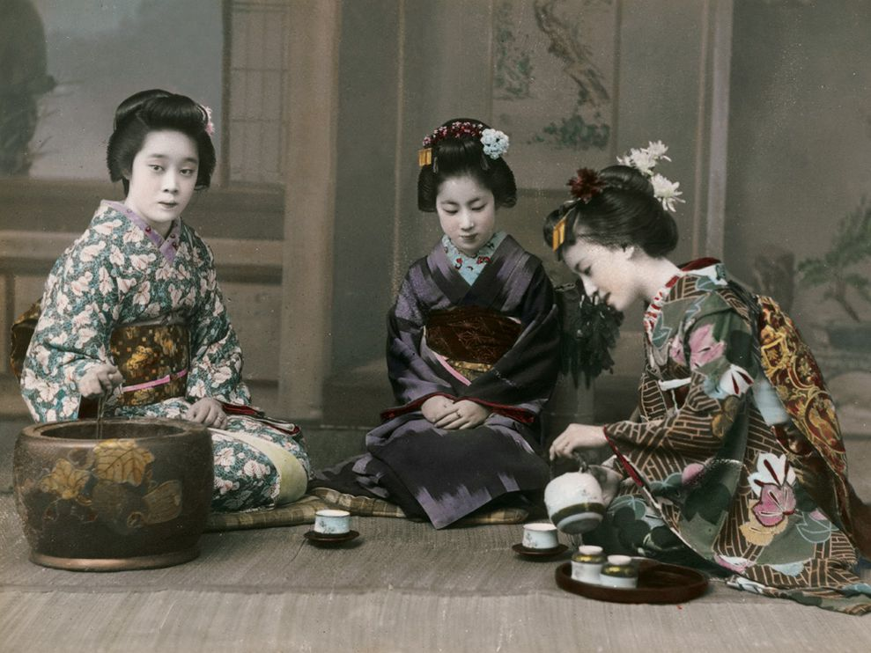
Japanese Tea Ceremony J T C
Japanese did not invent tea, or the tea pot,
( China did 1000 years prior). The Japanese just made tea a messed up crazy complex ritual.
Here is a rundown of the Japanese Tea Ceremony as quick and least boring as I can deliver it! Be quiet and listen.

Slide 9
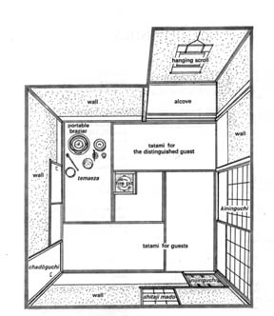
Tea Room

Slide 10
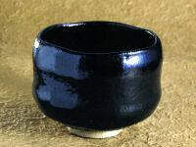
Equipment

Slide 11
Equipment
Chakin (茶巾?). The "chakin" is a small rectangular white linen or hemp cloth mainly used to wipe the tea bowl.
Tea bowl (茶碗 chawan?). Tea bowls are available in a wide range of sizes and styles, and different styles are used for thick and thin tea. Shallow bowls, which allow the tea to cool rapidly, are used in summer; deep bowls are used in winter. Bowls are frequently named by their creators or owners, or by a tea master. Bowls over four hundred years old are in use today, but only on unusually special occasions. The best bowls are thrown by hand, and some bowls are extremely valuable. Irregularities and imperfections are prized: they are often featured prominently as the "front" of the bowl.
Tea caddy (棗 Natsume?). The small lidded container in which the powdered tea is placed for use in the tea-making procedure([お]手前; [お]点前; [御]手前 [o]temae?).
Tea scoop (茶杓 chashaku?). Tea scoops generally are carved from a single piece of bamboo, although they may also be made of ivory or wood. They are used to scoop tea from the tea caddy into the tea bowl. Bamboo tea scoops in the most casual style have a nodule in the approximate center. Larger scoops are used to transfer tea into the tea caddy in the mizuya (preparation area), but these are not seen by guests. Different styles and colours are used in various tea traditions.
Tea whisk (茶筅 chasen?). This is the implement used to mix the powdered tea with the hot water. Tea whisks are carved from a single piece of bamboo. There are various types. Tea whisks quickly become worn and damaged with use, and the host should use a new one when holding a chakai or chaji.

Slide 12
Serving Equipment

Slide 13
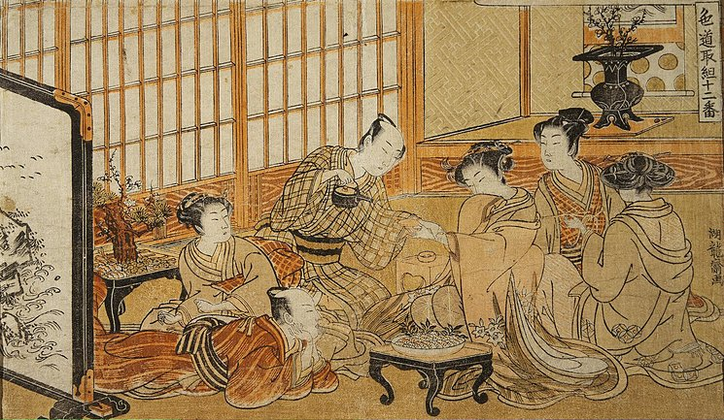
Long time ago

Slide 14
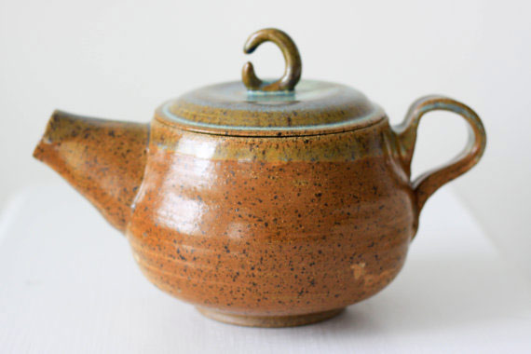
History of Teapots
Sung Dynasty (960-1279)

Slide 15
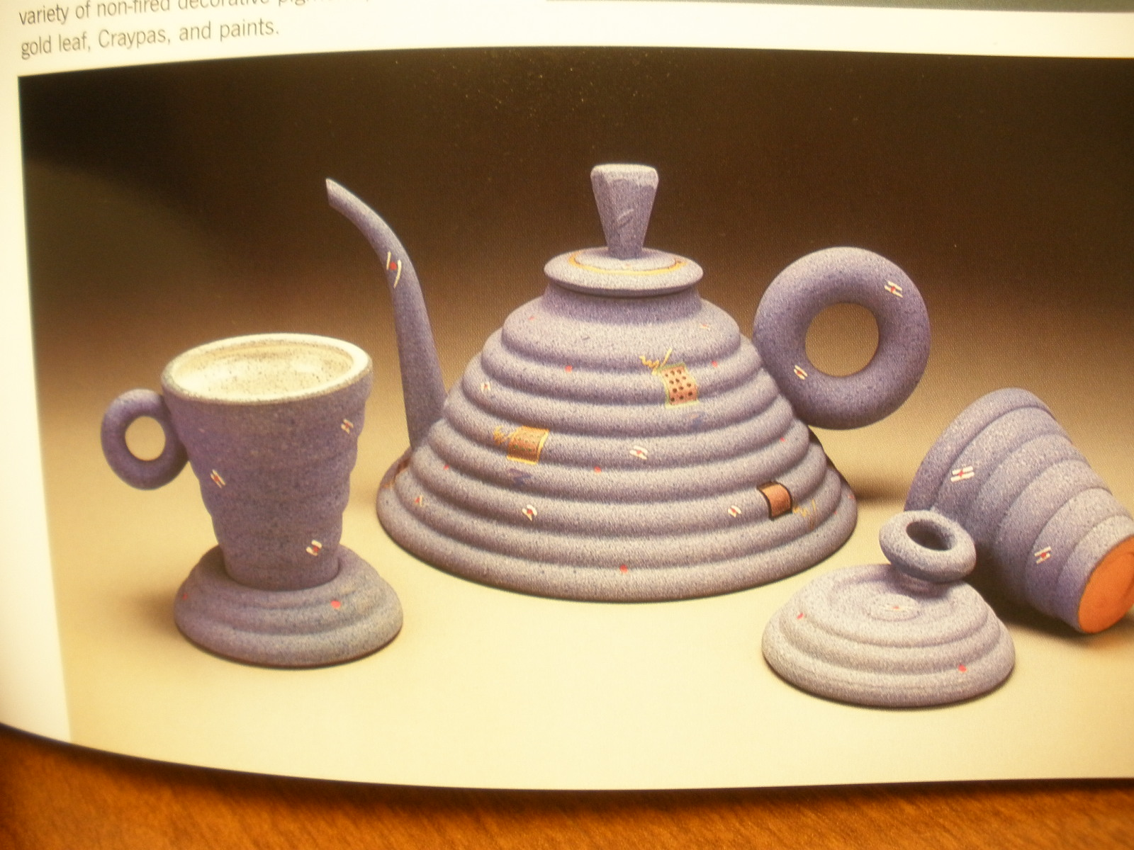
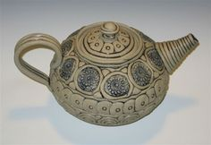
Methods
Coil

Slide 16
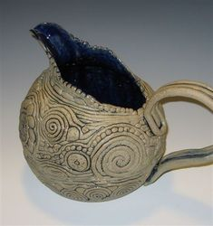
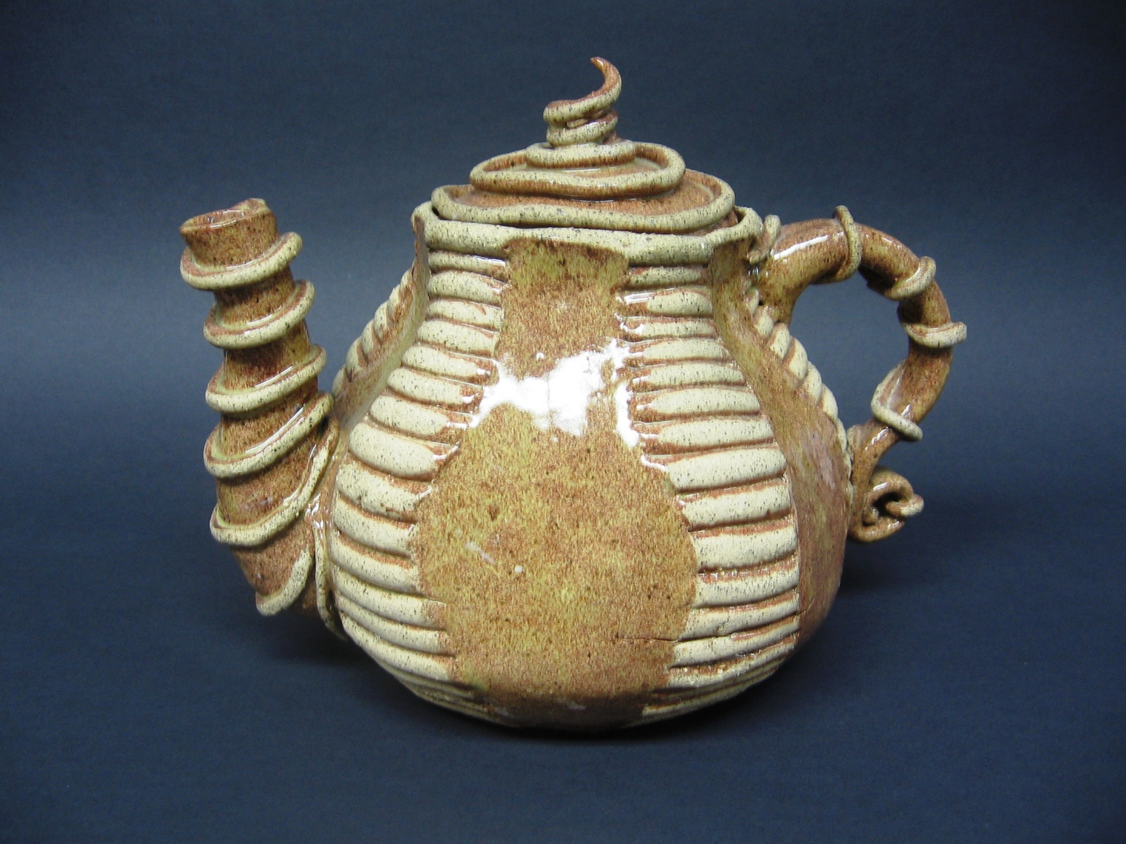

Slide 17
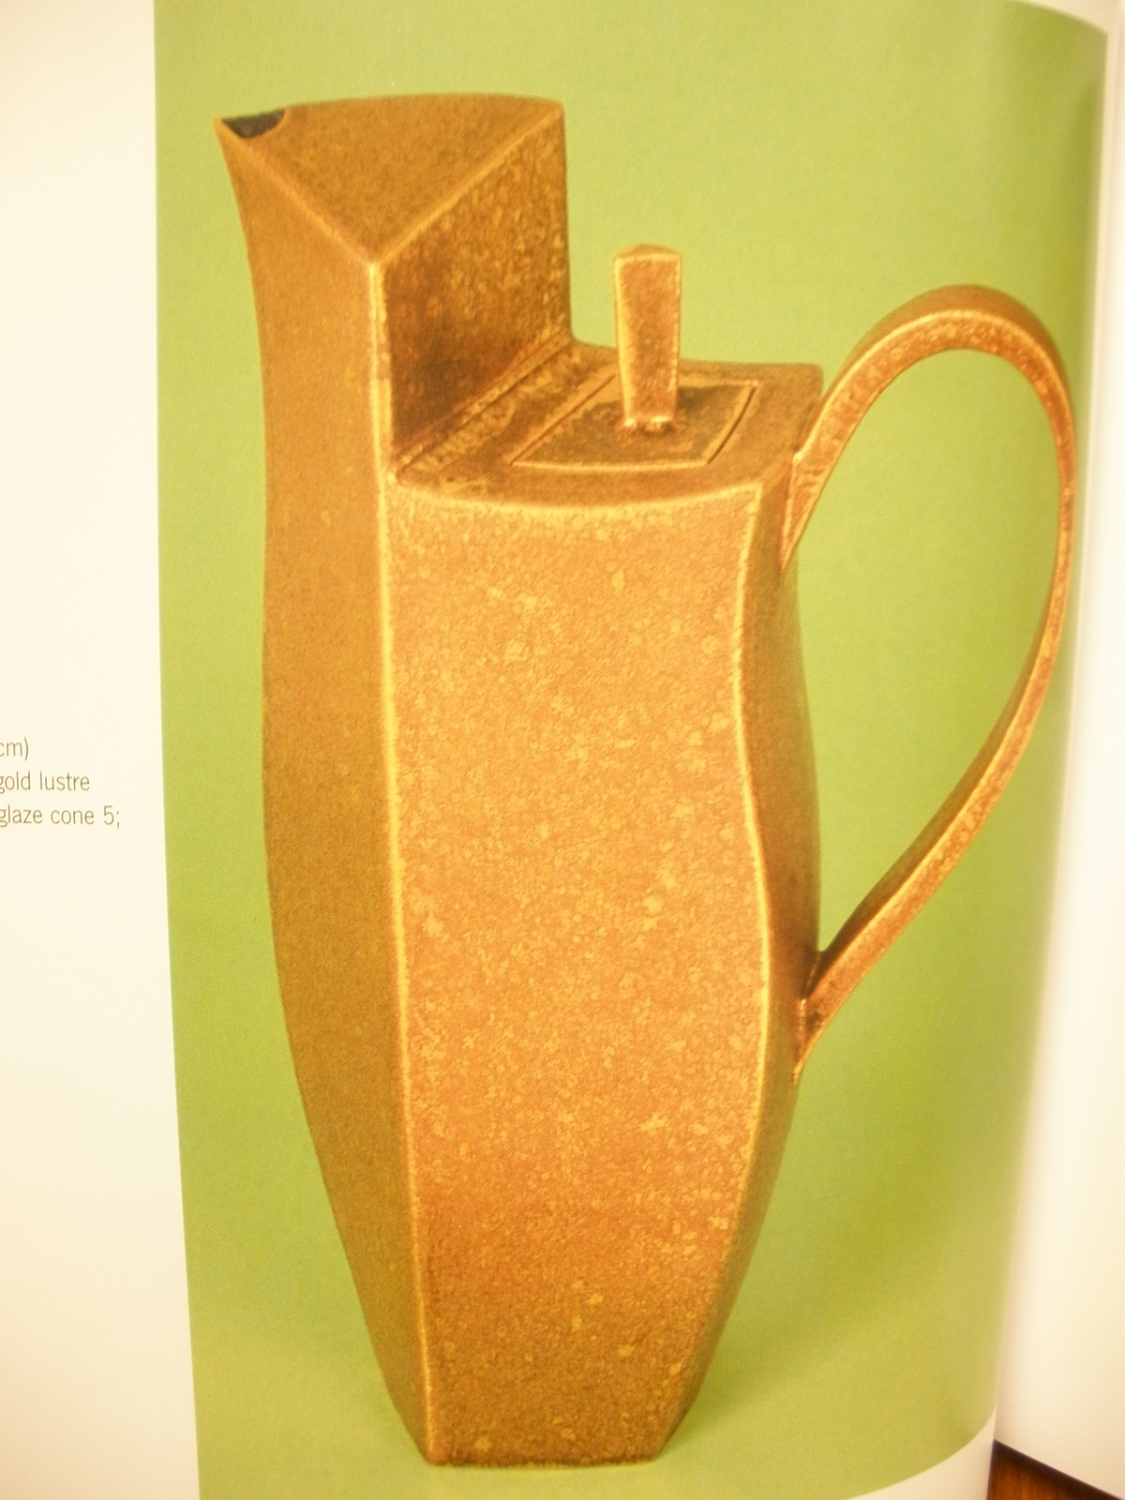
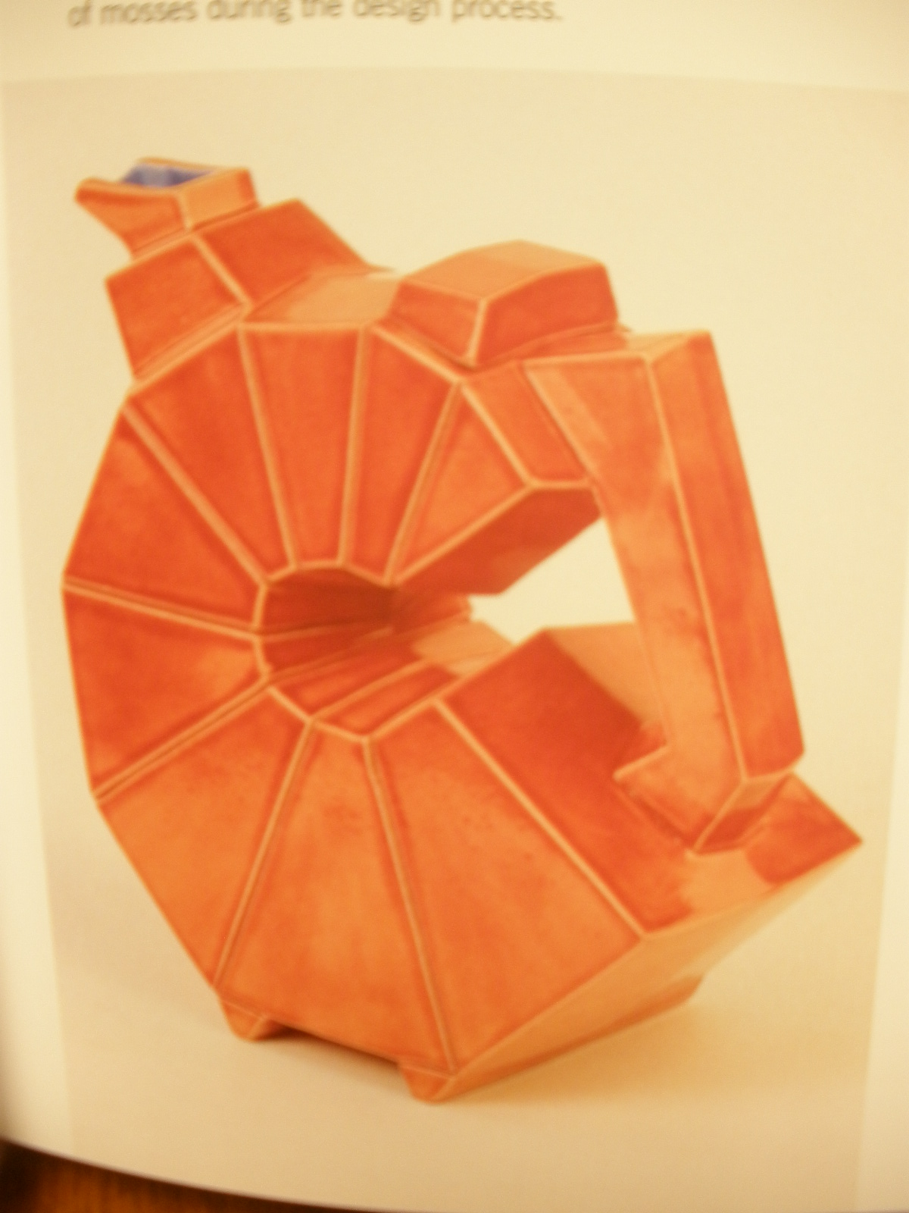
Slab

Slide 18
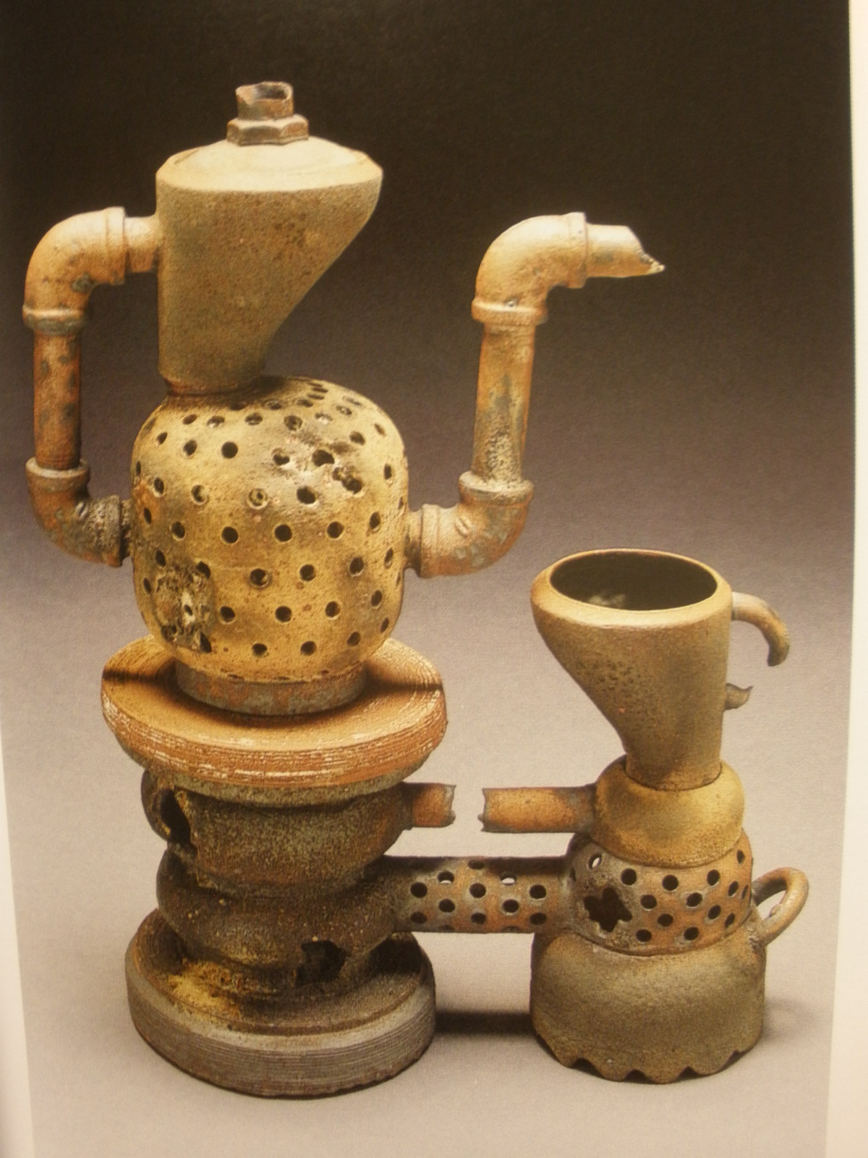
Hand Built

Slide 19
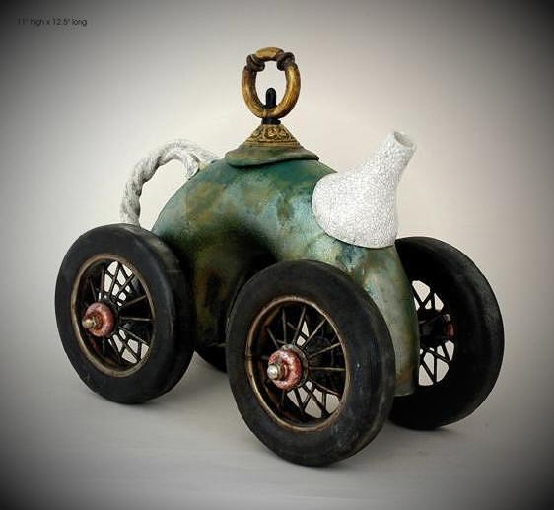
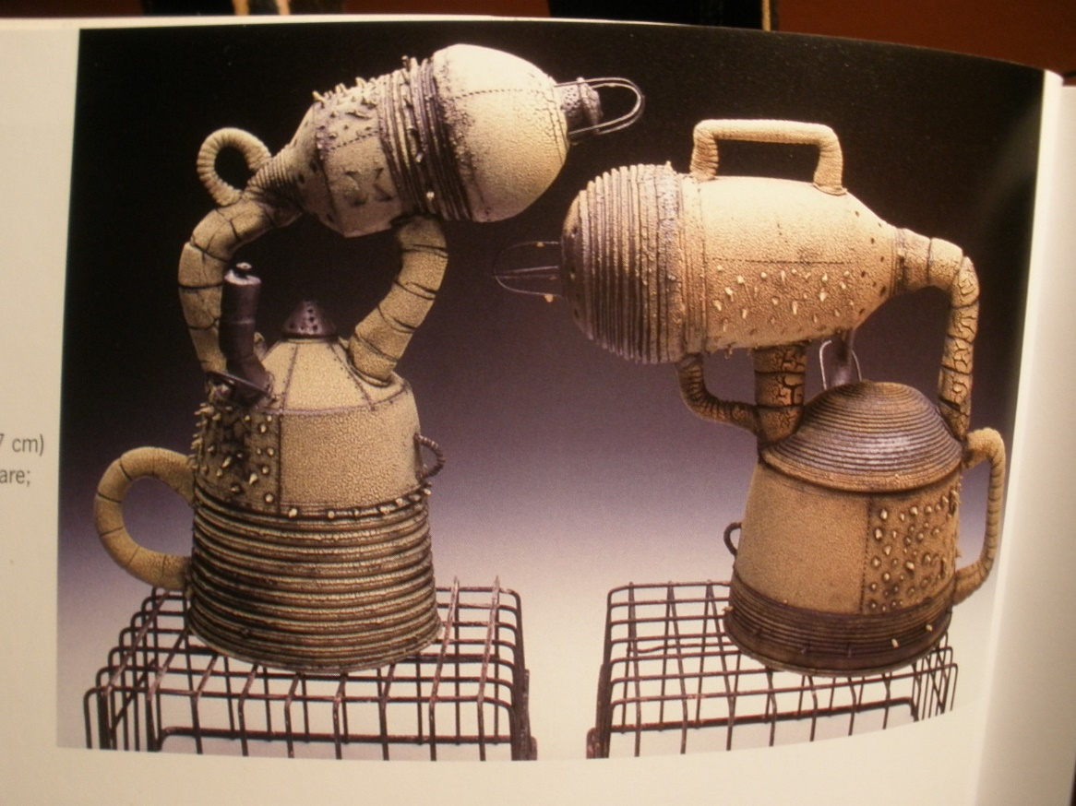
Mixed Media !!!!! Awesome! Eye catcher
You have to plan ahead what you want to add and design the clay teapot to hold it prior to firing. Then add the second medium after glazing and firing

Slide 20
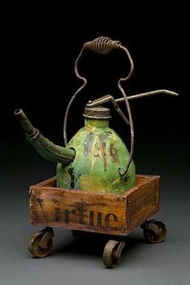
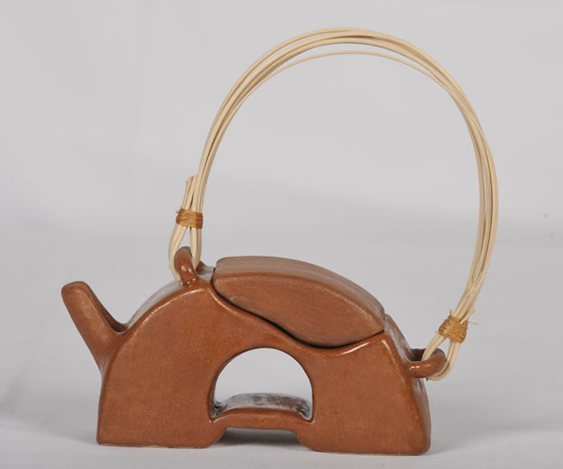

Slide 21
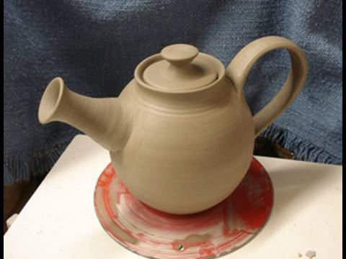
Wheel Thrown ( difficult ! – but if you are patient I’ll show you )
If you fail on the wheel you still have to make one somehow!

Slide 22
Decorating Phases
Greenware - while you clay is still wet you can add embellishments
Carve into it – scraffito
Add on little sculptures of things ( bugs, people, gears, ect. )
Other medium attachments ( Handle loops, ect )
Bisqueware – after it is fired
glaze it.
Add on other mediums that you pre-planned for.

Slide 23
Themes
Something you would not want to drink from
Something your would not want to touch
Animal
Building or industrial shape
Collage
Inanimate object
Appliance
Geometric
Melted
Etc. etc. etc. etc.

Slide 24
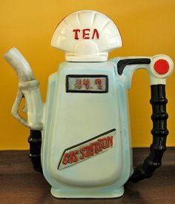
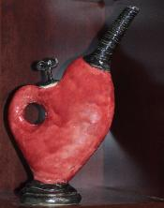
Ask questions don’t assume

Slide 25
CONTEST! Alvin ISD District Wide!
More information to come!!
Junior High 1st - 2nd - & 3rd Place Winners !
High School 1st – 2nd - & 3rd Place Winners !

Slide 26
Time & Grade
You have 2 ½ weeks to create your teapot in green ware.
Then what happens???
Do not sit and do nothing… I’ll be giving daily grades randomly
Bad Bettge ☹☹☹☹☹
You need a good good good good! Sketch prior to starting, even if you do not follow the sketch you need one!
Before you start thinking, lets look at some teapots together ☺

